Slide 1

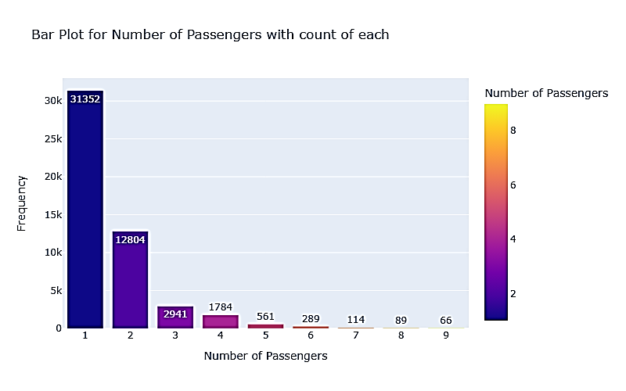
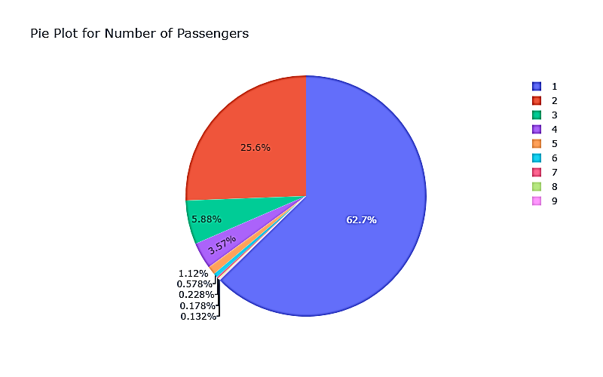

Forage British Airways Data Science Job Sim Task 2 - Predicting customer buying behaviour
Analysis: -

Slide 2
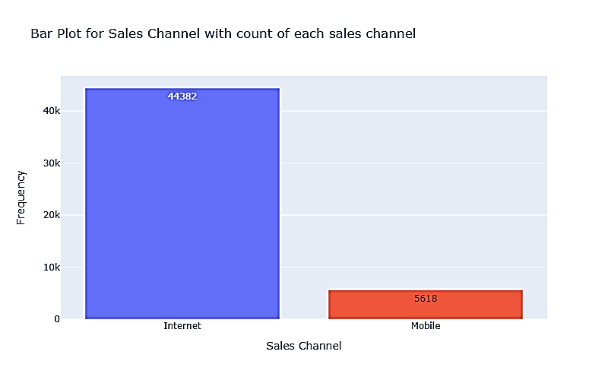
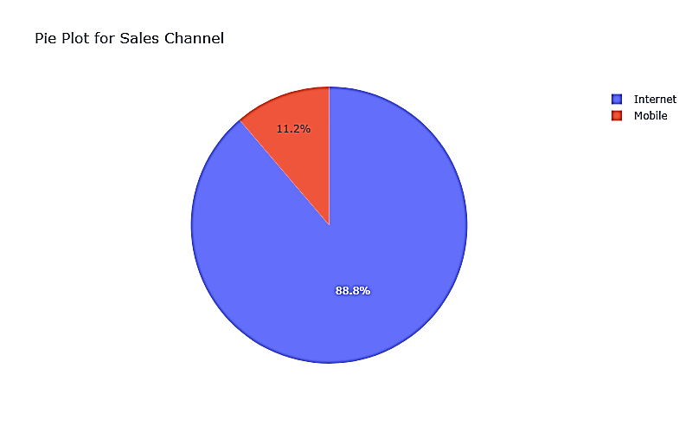
Forage British Airways Data Science Job Sim Task 2 - Predicting customer buying behaviour
Analysis: -

Slide 3
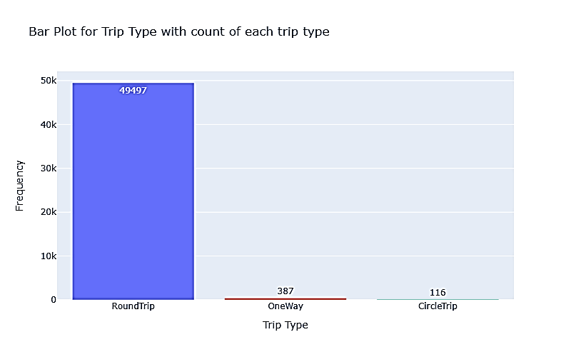
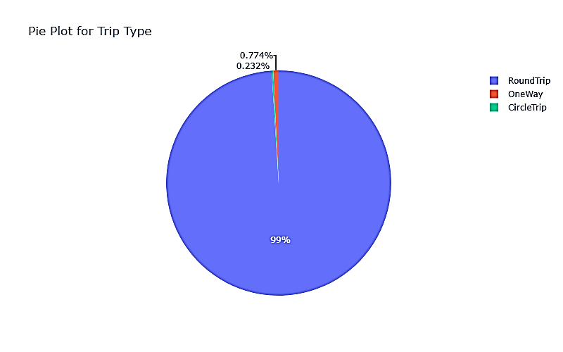
Forage British Airways Data Science Job Sim Task 2 - Predicting customer buying behaviour
Analysis: -

Slide 4
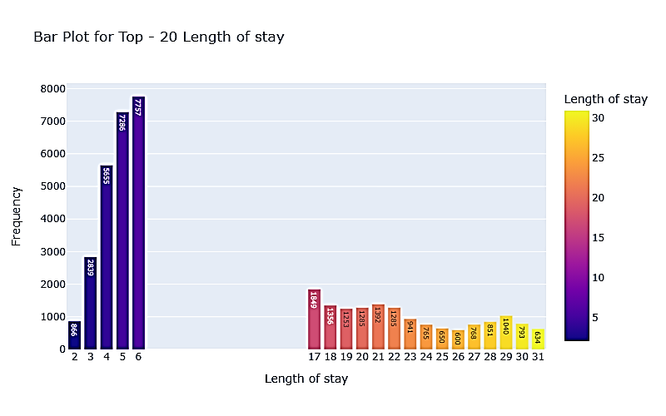
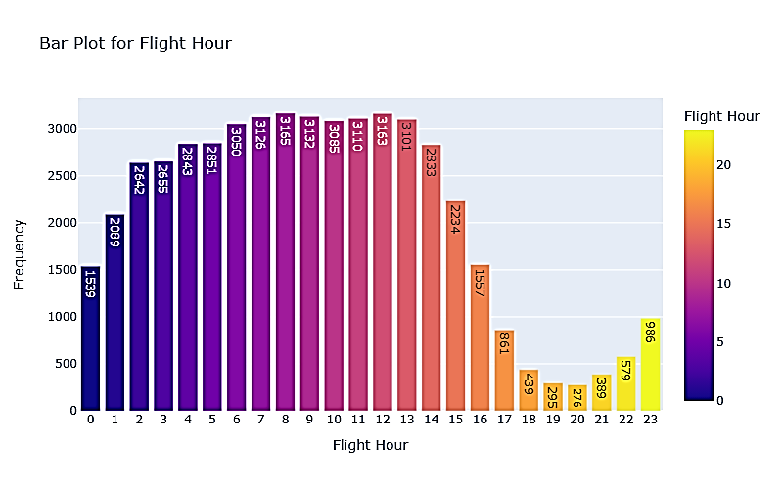
Forage British Airways Data Science Job Sim Task 2 - Predicting customer buying behaviour
Analysis: -

Slide 5
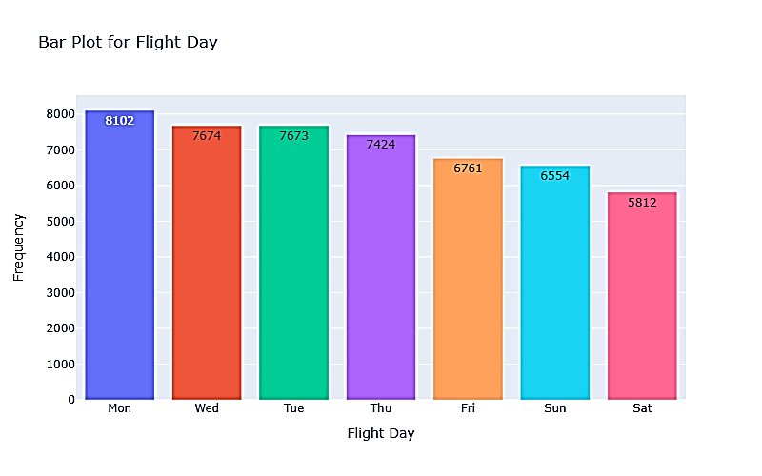
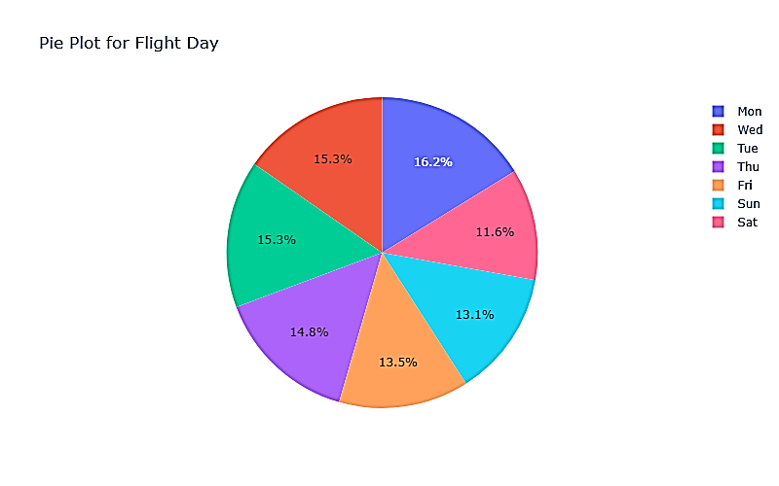
Forage British Airways Data Science Job Sim Task 2 - Predicting customer buying behaviour
Analysis: -

Slide 6
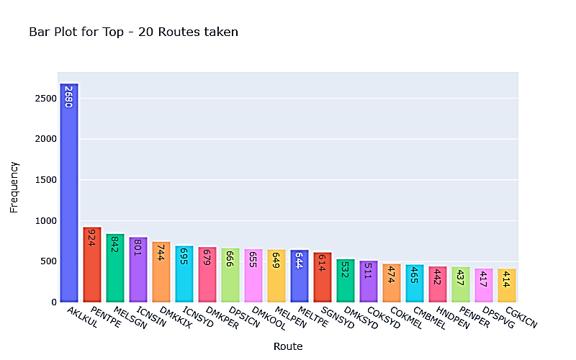
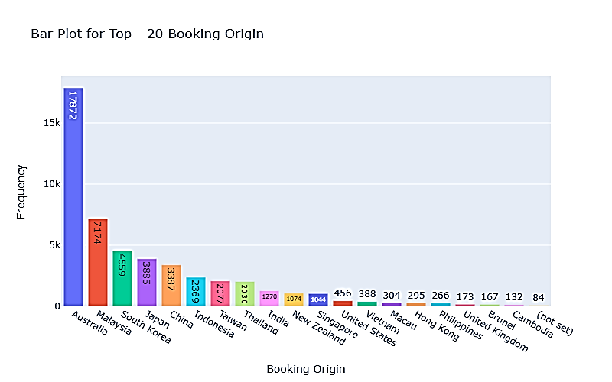
Forage British Airways Data Science Job Sim Task 2 - Predicting customer buying behaviour
Analysis: -

Slide 7
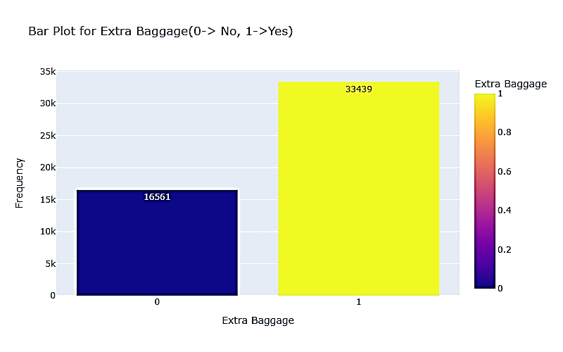
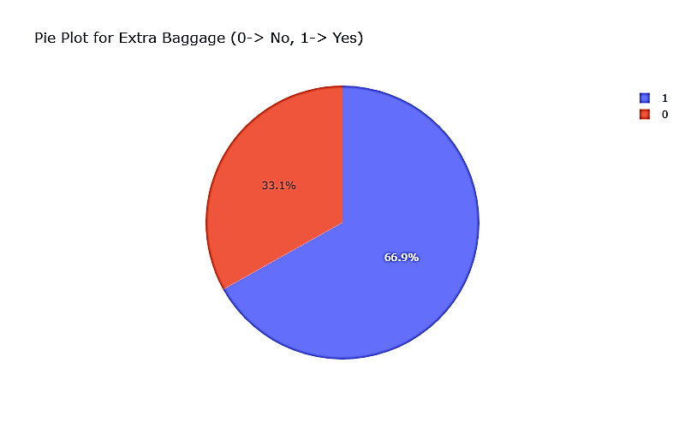
Forage British Airways Data Science Job Sim Task 2 - Predicting customer buying behaviour
Analysis: -

Slide 8
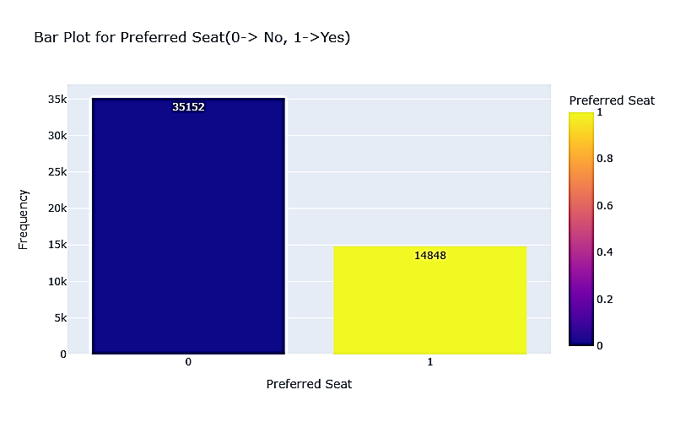
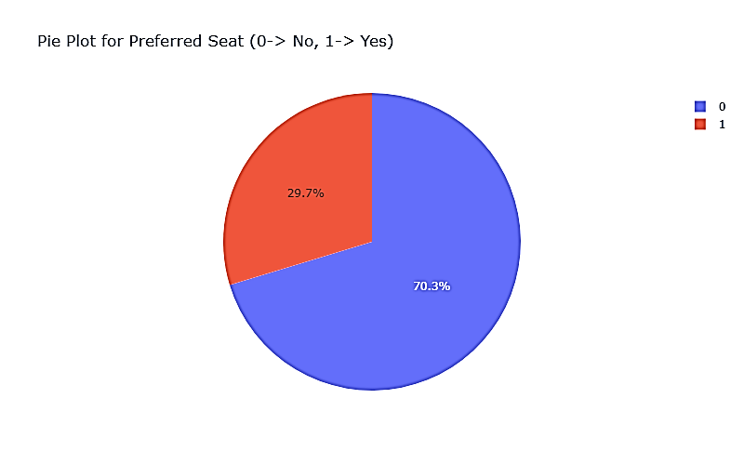
Forage British Airways Data Science Job Sim Task 2 - Predicting customer buying behaviour
Analysis: -

Slide 9
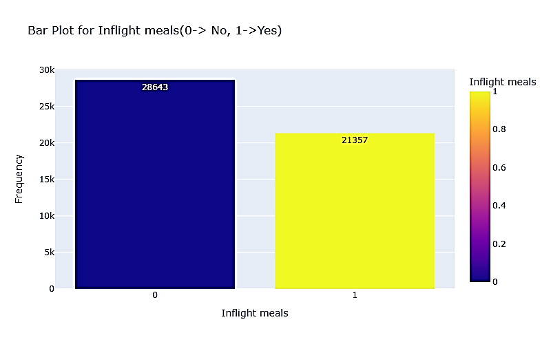
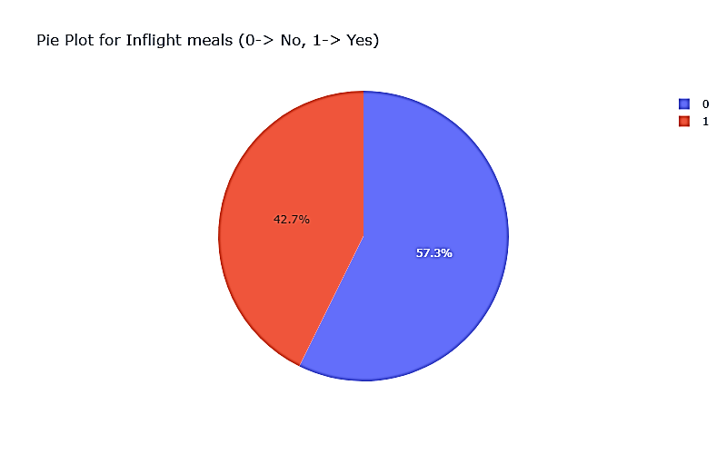
Forage British Airways Data Science Job Sim Task 2 - Predicting customer buying behaviour
Analysis: -

Slide 10
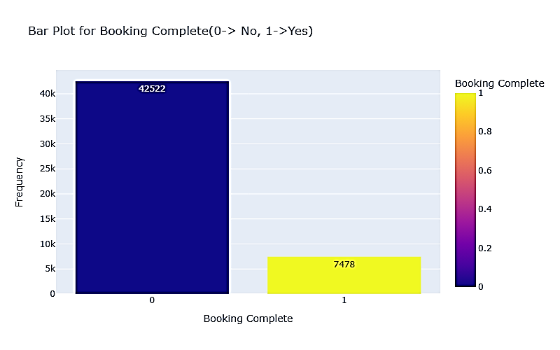
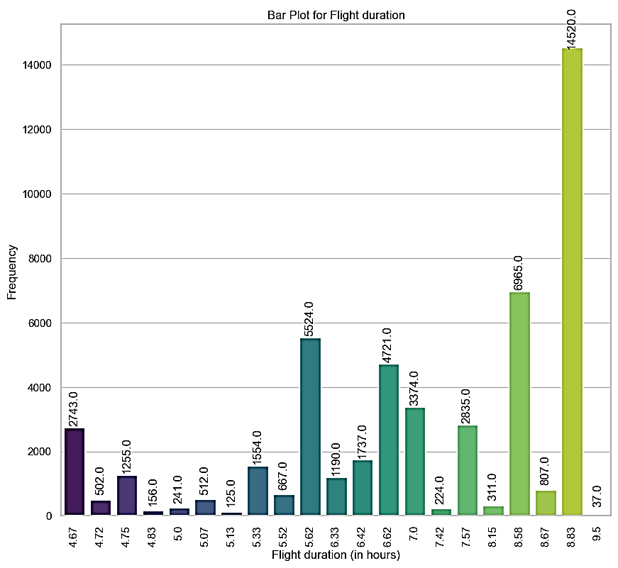
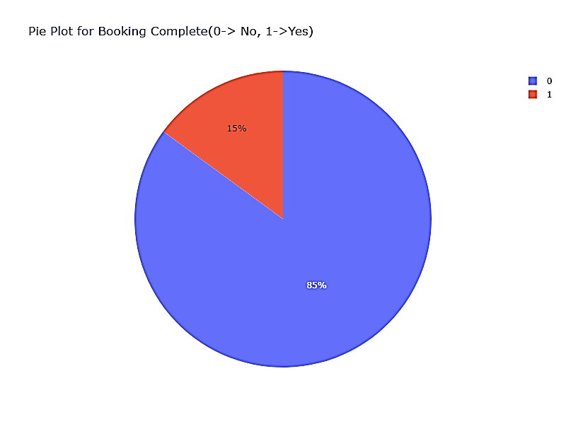
Forage British Airways Data Science Job Sim Task 2 - Predicting customer buying behaviour
Analysis: -

Slide 11
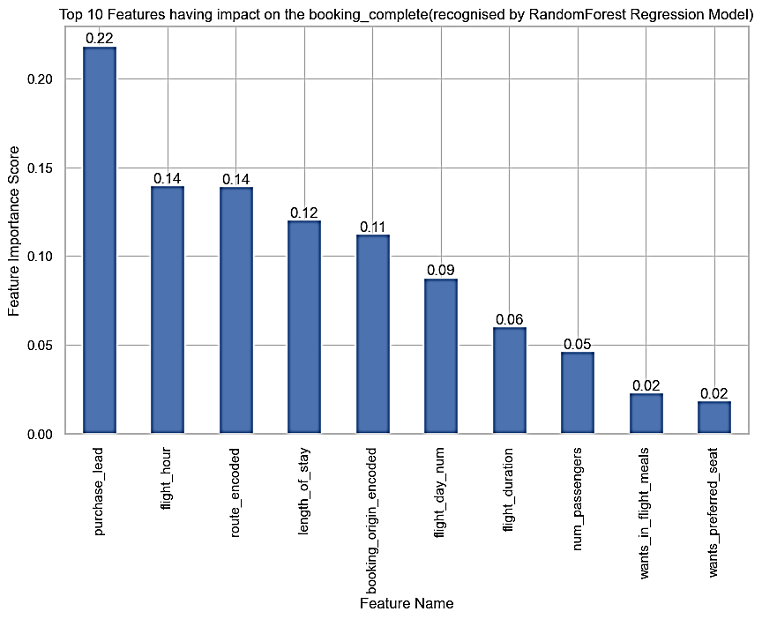
Forage British Airways Data Science Job Sim Task 2 - Predicting customer buying behaviour
Predictions: -
Using the RandomForestRegressor Model we have the following: -
R^2 score = 0.1056
From the feature importance plot we have ‘purchase_lead’ as the main feature having an impact score of 0.22

Slide 12
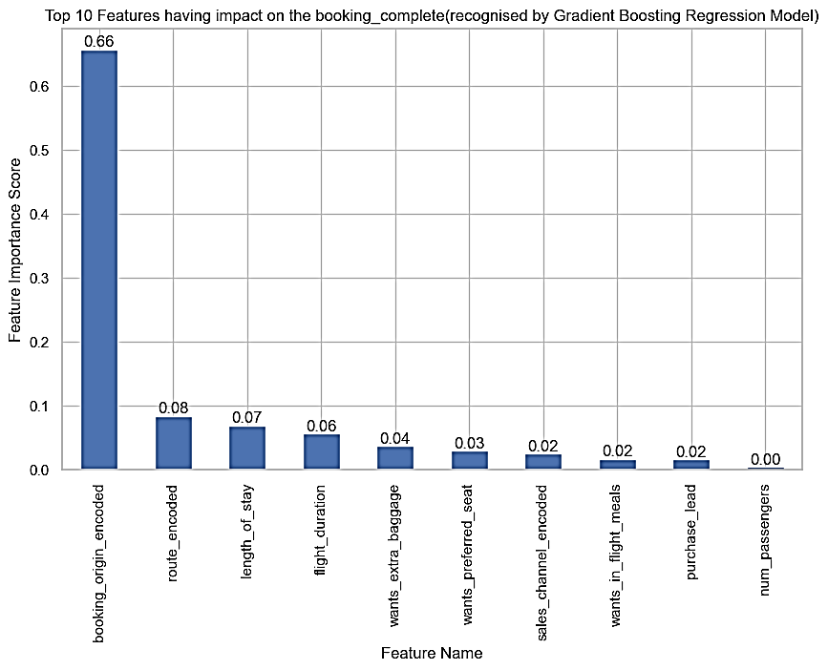
Forage British Airways Data Science Job Sim Task 2 - Predicting customer buying behaviour
Predictions: -
Using the Gradient Boosting Regression Model we have the following: -
R^2 score = 0.1158
From the feature importance plot we have ‘booking_origin_encoded’ as the main feature having an impact score of 0.66

Slide 13
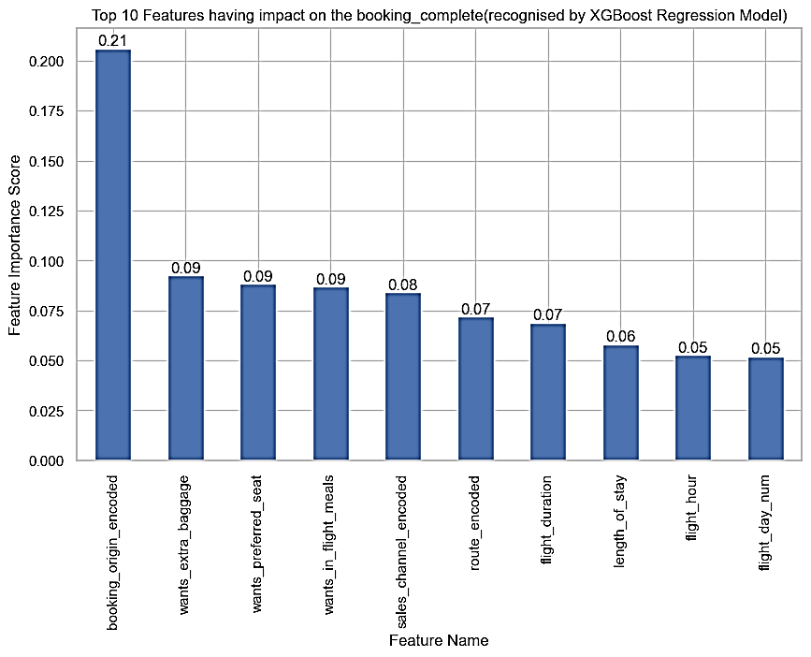
Forage British Airways Data Science Job Sim Task 2 - Predicting customer buying behaviour
Predictions: -
Using the XGBoost Regression Model we have the following: -
R^2 score = 0.1069
From the feature importance plot we have ‘booking_origin_encoded’ as the main feature having an impact score of 0.21

Slide 14
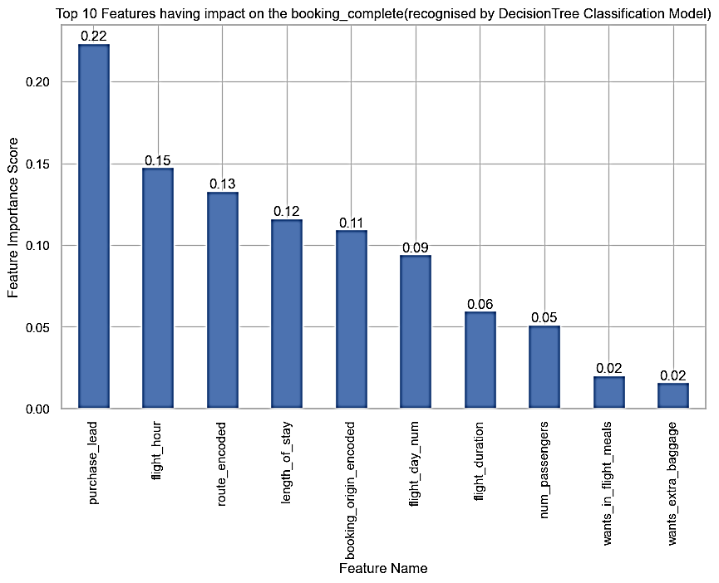
Forage British Airways Data Science Job Sim Task 2 - Predicting customer buying behaviour
Predictions: -
Using the Decision Tree Classification Model we have the following: -
Accuracy Score : 0.7818
From the feature importance plot we have ‘purchase_lead’ as the main feature having an impact score of 0.22

Slide 15
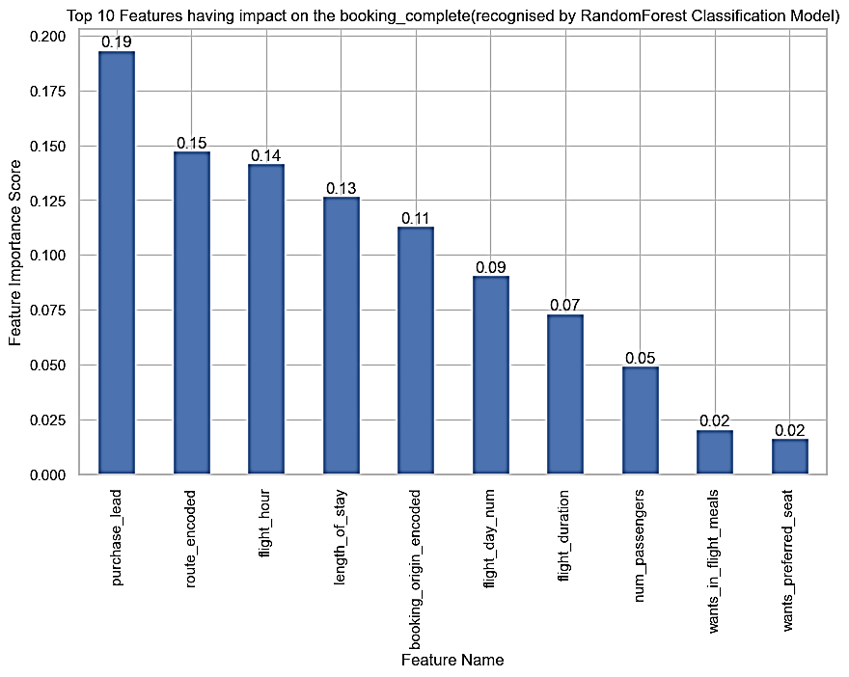
Forage British Airways Data Science Job Sim Task 2 - Predicting customer buying behaviour
Predictions: -
Using the Random Forest Classification Model we have the following: -
Accuracy Score : 0.8537
From the feature importance plot we have ‘purchase_lead’ as the main feature having an impact score of 0.19

Slide 16
Forage British Airways Data Science Job Sim Task 2 - Predicting customer buying behaviour
Follow the below mentioned link for more data insights: -
Forage British Airways Data Science Job Sim Task 2 - Predicting customer buying behaviour Python Notebook

